Slide 1
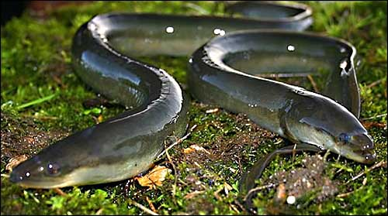
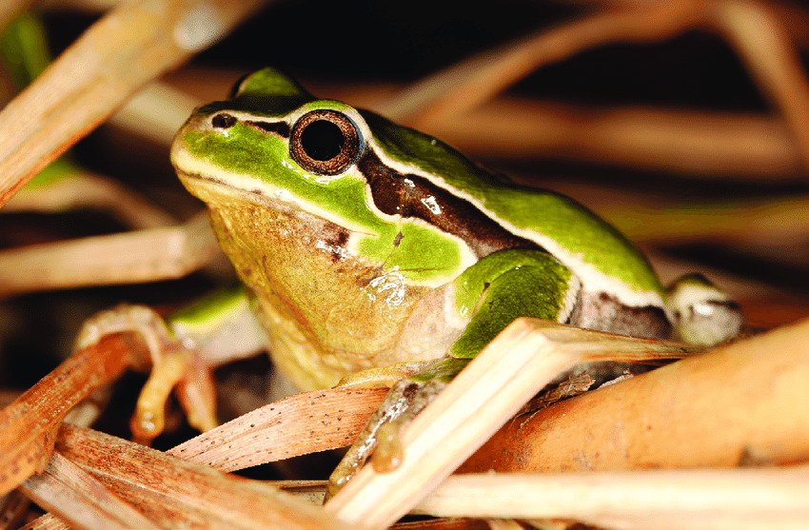
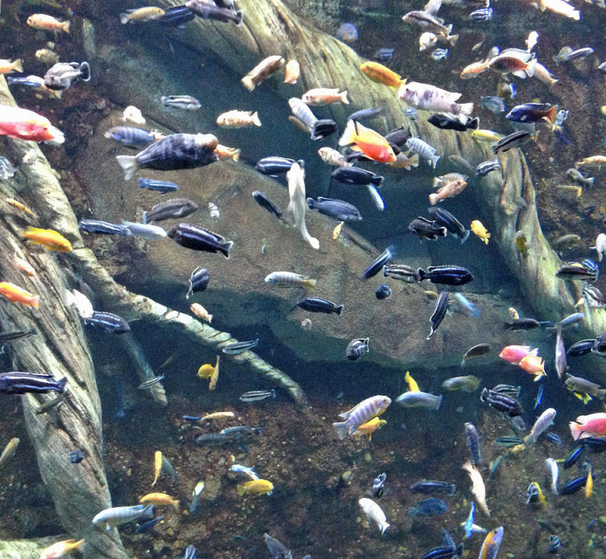
Molecular methods in Ecology and Evolution 2019

Slide 2
The goal of this course
To give you an insight to how biologists use specific techniques and tools to tackle ecological and evolutionary questions
To give you experience with some of these approaches, and the application of the scientific method to real-world systems.
Mitochondrial, Nuclear gene amplification and sequencing
Restriction site Associated DNA sequencing (RADseq).
Phylogenetic reconstruction
Population genetic data-exploration
Population structure analyses
Genomic-scale analyses of natural selection

Slide 3
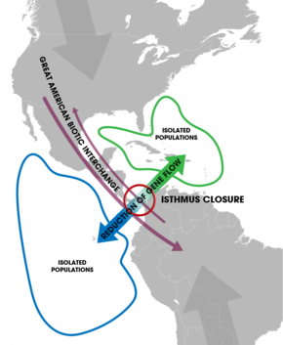
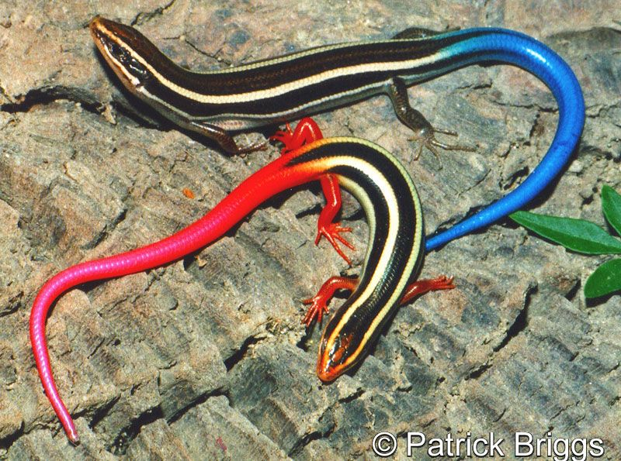
The theme of this course
The evolutionary drivers of population divergence and speciation,
Allopatric divergence
Ecological / sympatric divergence

Slide 4

Three projects
Project 1. Divergence/Speciation in tree frogs.
Allopatric divergence – are they different species?
Project 2. Speciation in lake Malawi cichlids
Ecological speciation in sympatry – what could be driving this?
Project 3. The curious case of the European Eel.
Can you explain the mysterious patterns of divergence?

Slide 5
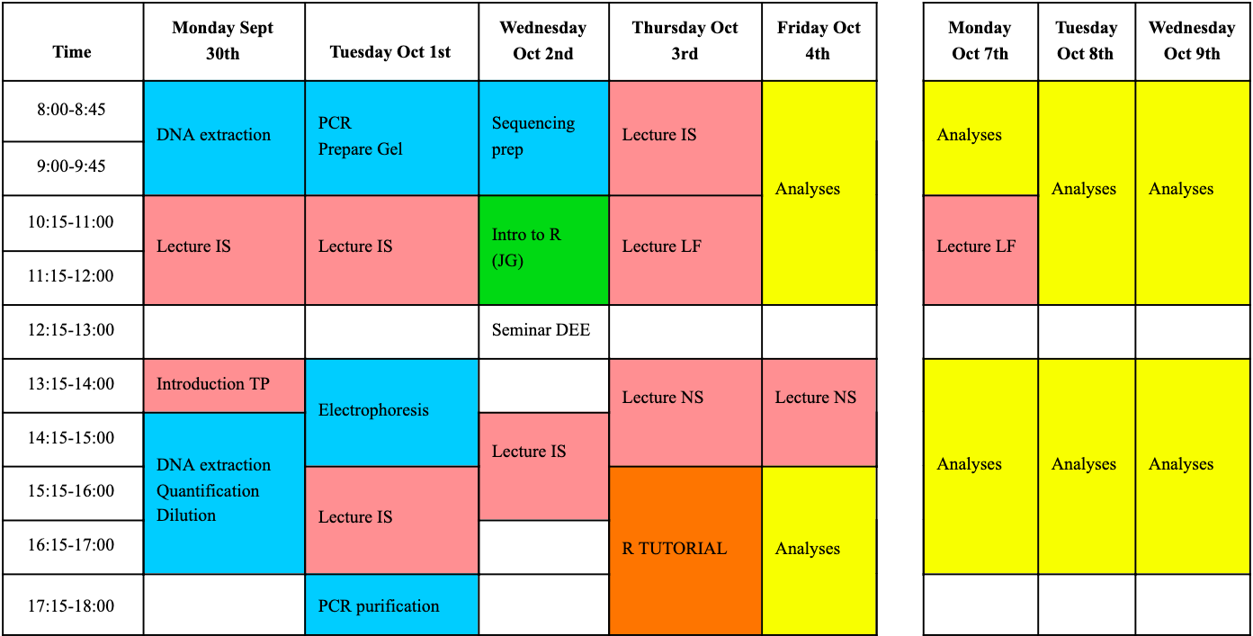
Project 1.
Project 2.
Project 3.

Slide 6
The report
Main introduction
- Project 1.
- Intro
- methods
- results
- discussion
- references
- Project 2.
- Intro
- methods
- results
- discussion
- references
- Project 3.
- Intro
- methods
- results
- discussion
- references
General Discussion
Lab methods & results in here
DEADLINE: 25 / 10 /19

Slide 7
Report grading
See “Advice on preparing your report” section in your manual, these guidelines are there to help you write your report, but will also be the basis of the marking scheme used to grade your reports.
Reports will be marked by 2 assistants each
*You will also be marked on your performance in the lab

Slide 8
Keeping a Lab book
While you are working in the lab, you should be keeping detailed notes of everything you do! You will need this information when writing the methods section of your report!

Slide 9
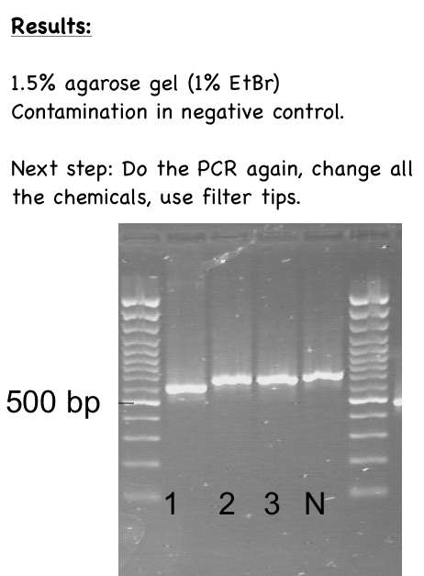
PCR on mitochondrial DNA of European cyprinid fish
Samples: DNA extracted from fins on Sept 30, 2014:
1-P.phoxinus, 2-C.Carpio, 3-G.gobio, 4-negative control
DNA concentrations: see page 13
For 1 individual:(x5)
-H20: 3.5 ul
-Buffer 10x Qiagen: 1 ul
-dNTPs mix of (2mM) each: 1 ul
-Primer F620 (10 uM): 0.5 ul
-Primer R110 (10 uM): 0.5 ul
-MgCl2 (25mM): 1 ul
-Taq Qiagen (5U.ml-1): 0.05
-DNA (20ng.ul-1): 2.45 ul
Total volume: 10 ul

Slide 10
Project 1. Divergence / Speciation in tree frogs

Slide 11
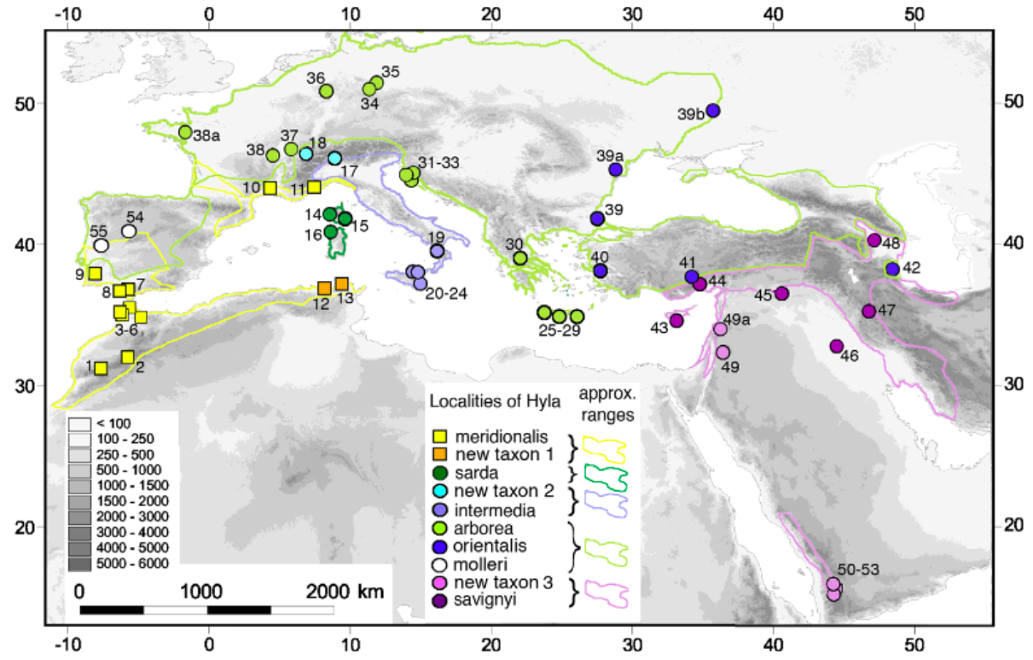
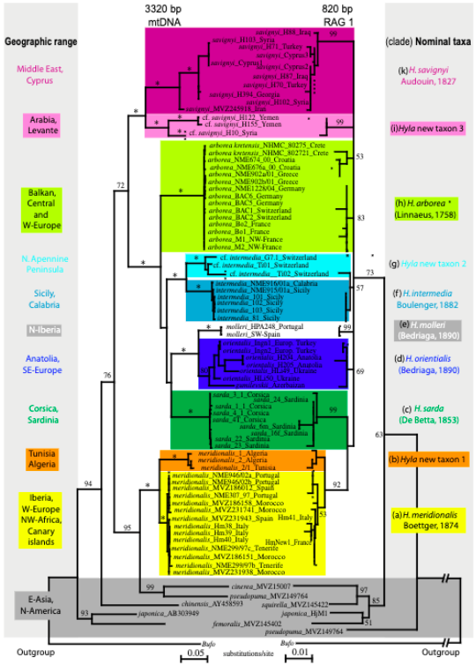
Stoeck et al 2008
?
Is “New taxon 2” a separate species?

Slide 12
Q.1. What caused the divergence between these lineages / species?
Q. 2. Are they one species, or two?
We will:
- Amplify mtDNA & Nuclear genes for frogs throughout Italy
Make a phylogeny to compare to the existing one
Analyse RADseq (genomic) data using PopGen approaches
Use this data to decide whether these frogs should be considered on species or two.

